Slide 1
Axon Framework implementation of CQRS

Slide 3
This framework provides a simple programming model for implementing even complex applications, which frees up the developer to focus on the business logic (such as the definition of the commands and the events to generate and their handlers). With a strong framework configuration, you can define the types of command-bus, event-bus, and event-repository, as well as the transactional aspect between various components and the type of serialization for data communication.

Slide 4
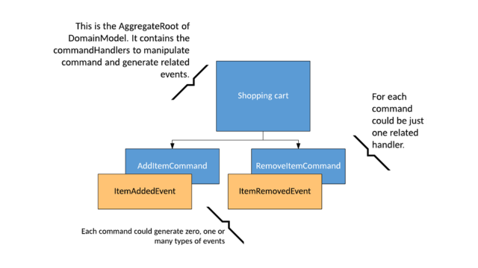
Step 1. Select the application context
Define the bounded context and its
domain entities. In that way, you will
define your AggregateRoot
An aggregate is "an entity or group of entities that is always kept in a consistent state. The aggregate root is the object on top of the aggregate tree that is responsible for maintaining this consistent state."

Slide 5
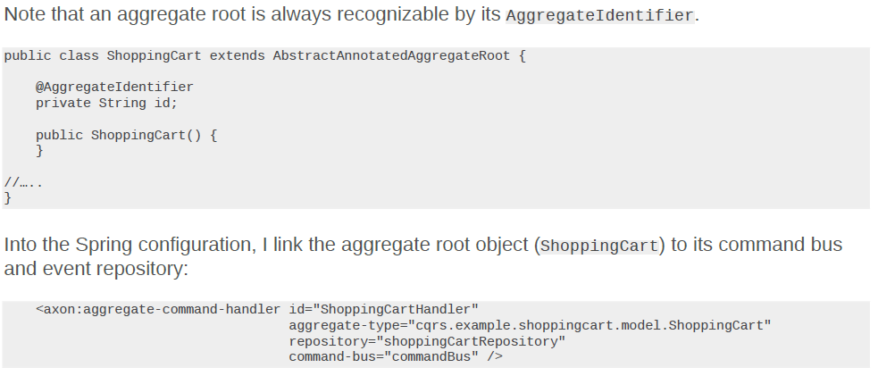

Slide 6
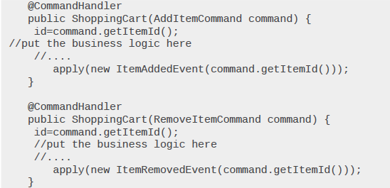
Step 2. Design commands and their handlers
AddItemCommand—adds a certain number of an item (in this case, a plant) to the shopping cart. It is dispatched asynchronously.
RemoveItemCommand—removes an object already in the cart, changing its availability in stock. It is dispatched asynchronously, because the system doesn't need to return any response to the user.
Cross cutting concerns – such as validation, logging, or authorization . The interceptor must implement the interface org.axonframework.commandhandling.CommandHandlerInterceptor

Slide 7
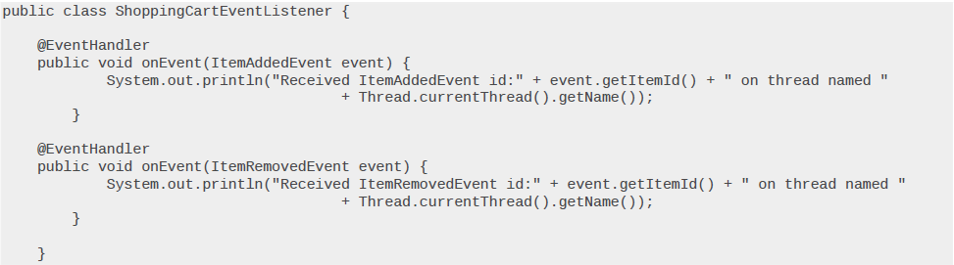
Step 3. Identify events and their listeners
Depending on the purpose of the listener, it is possible that the persistence of data is done on more than one database. Each database could have not only a separate model for queries, but also use a different technology (such as SQL DB, NoSQL DB, and so on).

Slide 8
Step 4. Configure the command handling
Through the command bus, each command is dispatched to its respective handler. The command bus definition is inserted into the configuration Spring file.
In the commandBus definition, you'll see the transaction manager reference; it is used to manage the transaction during command handling.
In adopting the CQRS pattern for use in your application development, consider this transactional aspect of CQRS. Commands cannot be lost. You need a transaction manager (to handle ACID transactions) to ensure that every command is processed and that the events are generated and made persistent in the event store. This holds true for command handling, but if you consider the entire transaction (from running the command to the event listener execution) in regard to the asynchronous characteristics of flow, it is a BASE transaction. BASE is an acronym for Basic Available, Soft state, Eventually consistent.

Slide 9
Step 4. Configure the command handling – Contd.
One result of this is the need to rethink the transaction rollback. In the BASE model, the transaction rollback is not automatic; you must design appropriate compensation actions for it. For example, if a user confirms his cart and buys the items, the application executes the related purchase command. If it is committed (as an ACID transaction), you can no longer act on it. Everything that happens next is asynchronous with respect to this command execution. Now, imagine that the listener of the purchase event has the purpose of starting the payment process. If the payment is not successful, the purchase command cannot be rolled back. Instead, the purchase must be canceled and the user notified. Figure illustrates this business process.

Slide 10
Step 5. Look for long-running transactions
SAGA is often defined as a "long-lived business transaction or process." The foundational theory behind it is to avoid the use of blocking (and locking)transactions across lots of resources
In our purchase example, when a ProductPurchased event is generated in some way, a SAGAobject associated with it sends a CreateInvoice command and a PrepareDelivery command. Thisis how the purchase process (or at least part of it) is executed.
Note that SAGA objects contain business behavior, but only in the form of process. This is a criticalpoint: In their purest form, SAGA objects do not contain business logic

Slide 11
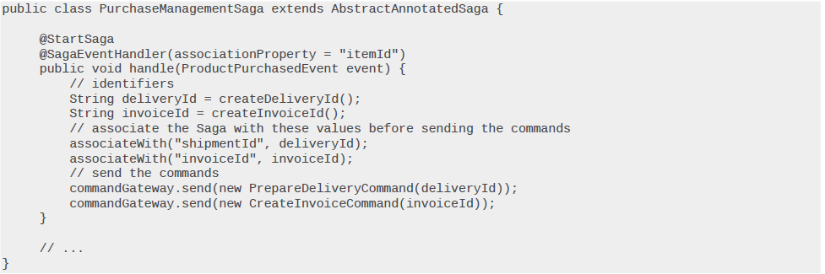
Step 5. Look for long-running transactions – Contd.

Slide 12
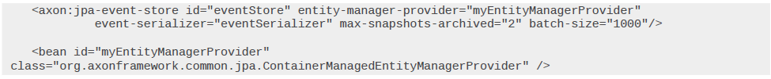
Step 6. Manage event sourcing
In addition to CQRS, the Axon Framework also implements an event sourcing pattern, to link commands to the queries. The use of event sourcing brings a lot of benefits, the most important of which is to have a system where everything is traced by design. (In a traditional application, you need to log to know who has done what.) All the events generated are persisted into the eventstore.
The relational database used for the event store
The event store's datasource definition.

Slide 13
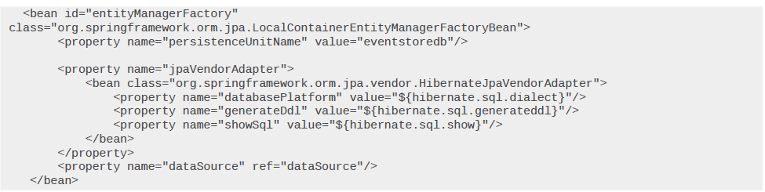
The entityManagerFactory (the bean that provides the database connections) is defined this way:

Slide 14
In the event store, you can find the tables DOMAINEVENTENTRY and SNAPSHOTEVENTENTRY(created by the framework the first time), each of which has the following columns:
DOMAINEVENTENTRY table content sample

Slide 15
The event bus is the mechanism that dispatches the events to their listeners. Each event can have one or more listeners associated with it. Using the default implementation, you would write:
The framework makes two implementations available:
The SimpleEventBus is applicable in most cases where dispatching is done synchronously and locally (such as in a single JVM).
The ClusteringEventBus is suitable when your application requires Events to be published across multiple JVMs (that is, in a cloud ecosystem). The dispatching is therefore asynchronous and distributed. Figure 7 illustrates a clustering event bus.

Slide 17
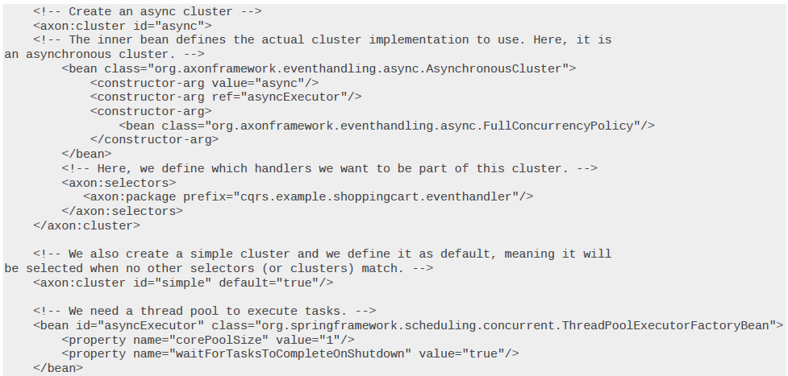
ClusteringEventBus can define an EventBusTerminal as well. That way, you can distribute events to transmit events to an AMQP-compatible message broker, such as Rabbit MQ.

Slide 18
Step 7. Choose event serialization
JSON format using org.axonframework.serializer.json.JacksonSerializer

Slide 19
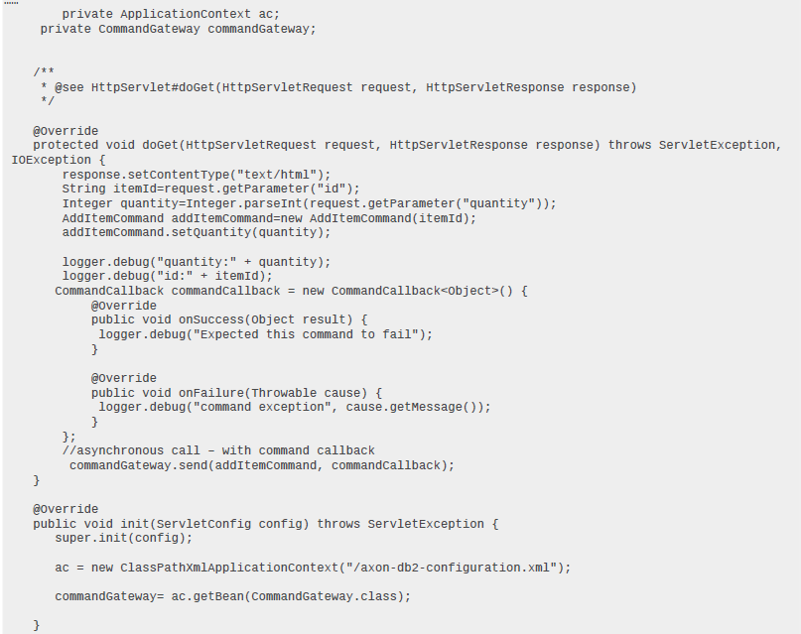
Step 8. Interact with the application
To interact with a service, you can implement REST services, separating the command service
(HTTP Put Request) from the query services (HTTP Get Request).
The user interface interacts through a servlet, in which the commands are dispatched by a CommandGateway:

Slide 20
Step 9. The deployment
Bluemix PaaS deployment
Deployment as a single macro component
In deploying my application on Bluemix, the packaging consists of:
A component for command handling—update requests (HTTP POSTs).
A component for query handling—view requests, separate from command services (HTTPGETs).
A component for event handling—contains the event listeners.
The application binds two Bluemix services (DB2 and MongoDB) for persistence of command dataand event sourcing.

Slide 21
Deployment in macro components

Slide 22
Deployment with Bluemix containers

